Slide 1
Thesis Pictures

Slide 2
Parent Class: CSolver
CSolver
CSysMatrix Jacobian
CEulerSolver
CNSSolver
CSysVector rhs & sol
CTurbSolver
CTurbSASolver
CSysSolve System
CTurbSSTSolver
A
B
B是A的子类
A
B
B是A的类成员变量

Slide 5
warp0
warp1
warp2
warp3
warp4
warp5
warp6

Slide 7
A⁻¹
B
C
D
warp0
warp1
warp2
warp3
warp4
warp5
warp6

Slide 9
lane_Id_div_16 = 0
lane_Id_div_16 = 1
线程
共享内存

Slide 10
线程
共享内存

Slide 12
1
2
3
4
5
6
7
8
9

Slide 13
1
2
3
4
5
6
7
8
9

Slide 15
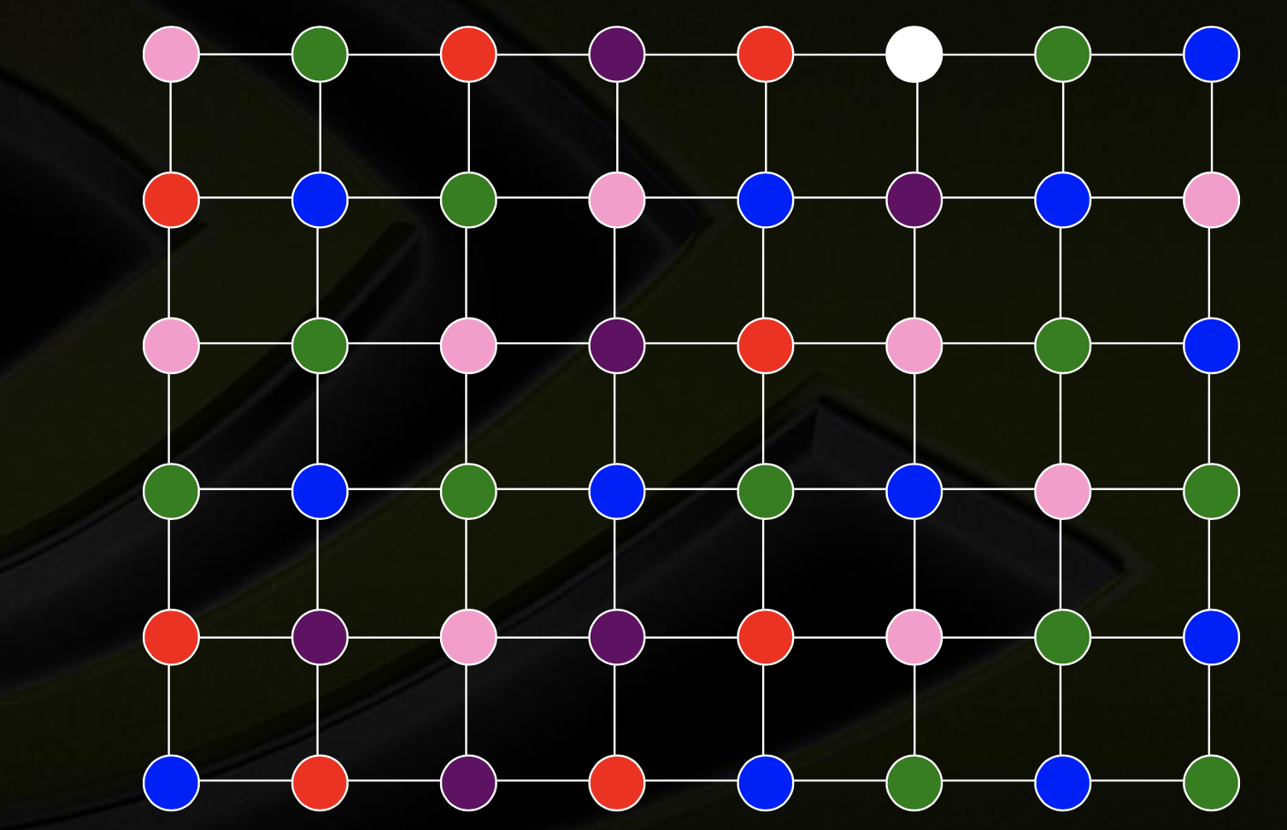

Slide 18
5
8
当地最大值
2
4
6
7
当地最小值
1
3
邻点

Slide 20
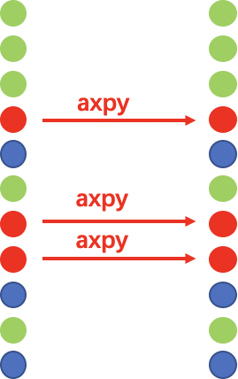
向量校正

